Slide 1
Batch-11
PGP-DSE-Feb-2022
Project Topic : Backorder Prediction
Domain : E-Commerce (Supply Chain)
Mentor : Pratik Sonar
Team:
Vigneshwar K (Team Leader)
TamilSelvan M
Balaji Prasanth S
Rahul R
Adarsh R

Slide 2
Problem Statement & Solution
Statement: Part backorders is a common supply chain problem, wherein a customer places an order for a product that is temporarily out of stock. The percentage of items backordered and the number of backorder days are important measures of the quality of a company's customer service and the effectiveness of its inventory management.
Understanding: Backorders are unavoidable, but by anticipating which things will be backordered, planning can be streamlined at several levels, preventing unexpected strain on production, logistics, and transportation. Based on past data from inventories, supply chain, and sales, products are classified as going into backorder (Yes or No).
Proposed Solution: Based on the historical data, we have tried out different Machine Learning models and choose the best model to analyze the factors that are key to the business and classify the product will go into backorder or not.

Slide 3
Data Description
S.No | Feature Name | Feature Description
1. | national_inv | Current inventory level for the part
2. | lead_time | Transit time for product (if available)
3. | in_transit_qty | Amount of product in transit from source
4. | forecast_3_month | Forecast sales for the next 3 months
5. | forecast_6_month | Forecast sales for the next 6 months
6. | forecast_9_month | Forecast sales for the next 9 months
7. | sales_1_month | Sales quantity for the prior 1-month time period
8. | sales_3_month | Sales quantity for the prior 3-month time period
9. | sales_6_month | Sales quantity for the prior 6-month time period
10. | sales_9_month | Sales quantity for the prior 9-month time period
11. | min_bank | Minimum recommend amount to stock
12. | potential_issue | Source issue for part identified
13. | pieces_past_due | Parts overdue from source
14. | perf_6_month_avg | Source performance for prior 6 month period
15. | perf_12_month_avg | Source performance for prior 12-month period
16. | local_bo_qty | Amount of stock orders overdue
17. | deck_risk | Part risk flag
18. | oe_constraint | Part risk flag
19. | ppap_risk | Part risk flag
20. | stop_auto_buy | Part risk flag
21. | rev_stop | Part risk flag
22. | went_on_backorder | Target Variable
Variable Categorization
Independent variables:
Numerical column: 15
Categorical column: 7
Target variable:
Categorical - 1

Slide 4
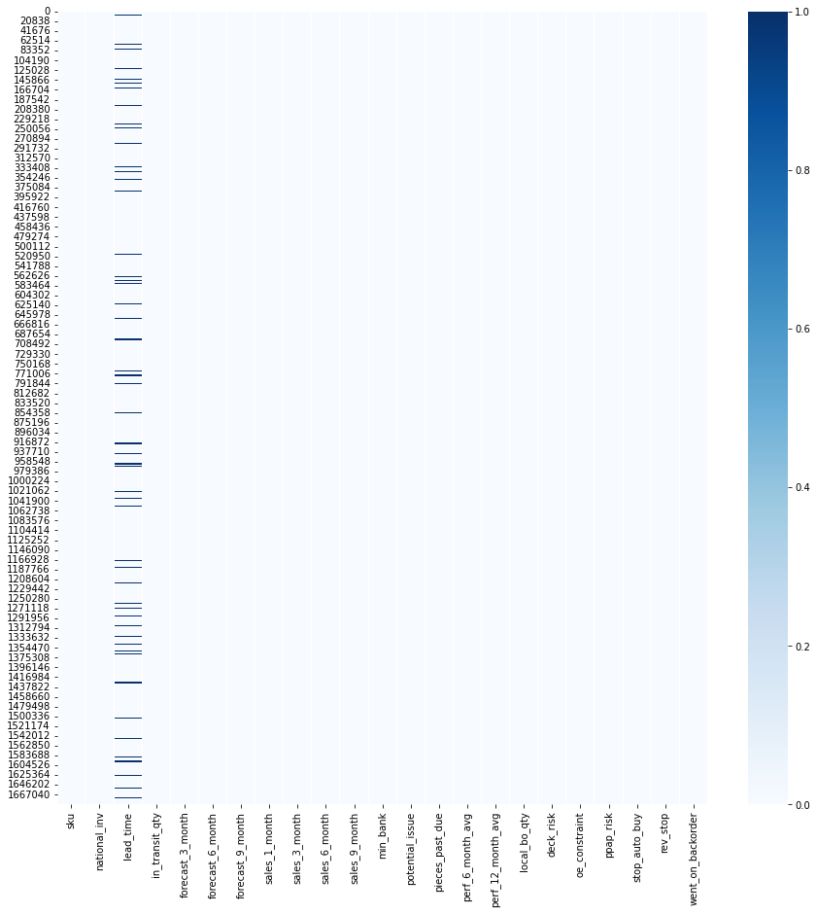
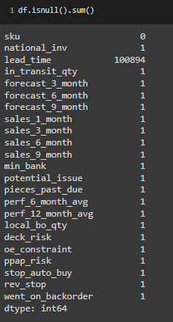
Null Value and its Treatment
Majority of Null values are present in Lead time.
Non Null values like -99 have been replaced with np.Nan and imputed with median value
We has one entire row of Null value, which we have removed.

Slide 5
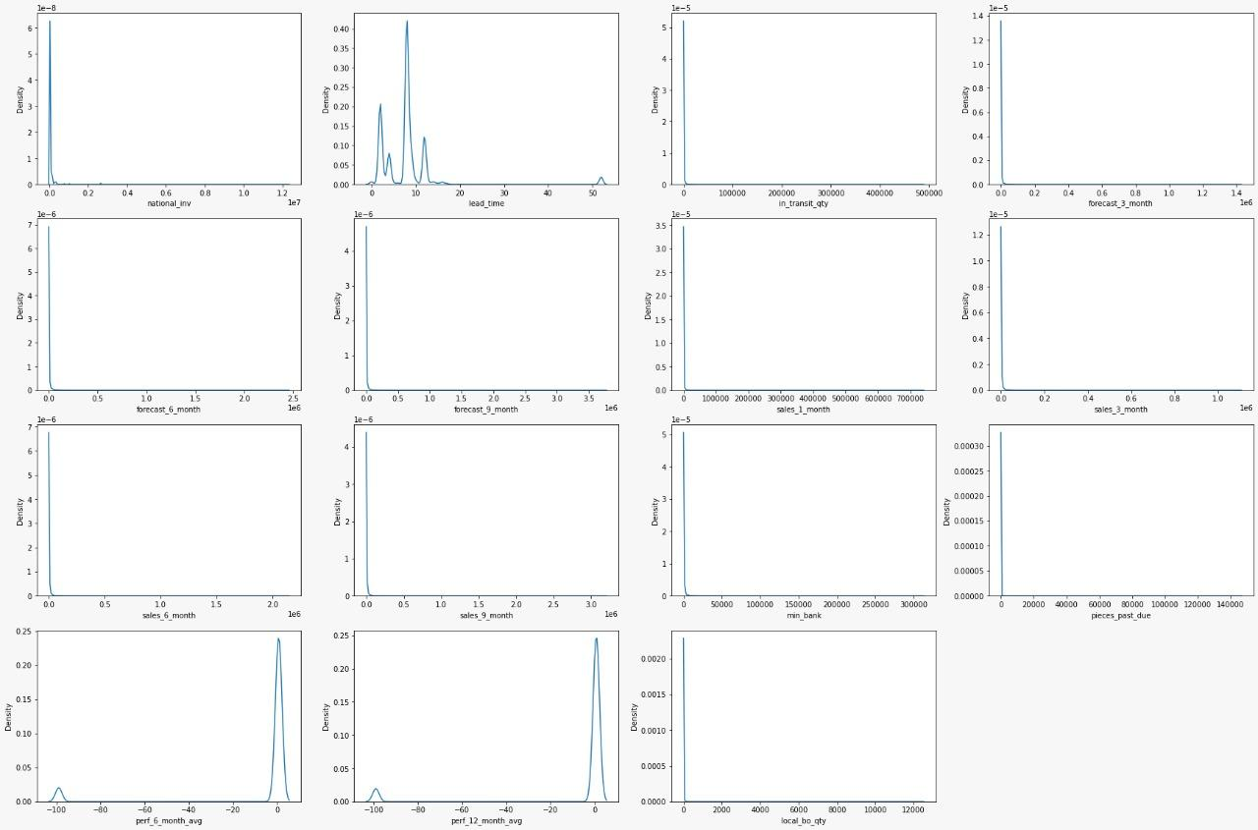
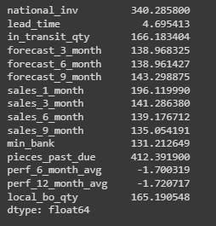
Distribution of Features
Skewness:

Slide 6
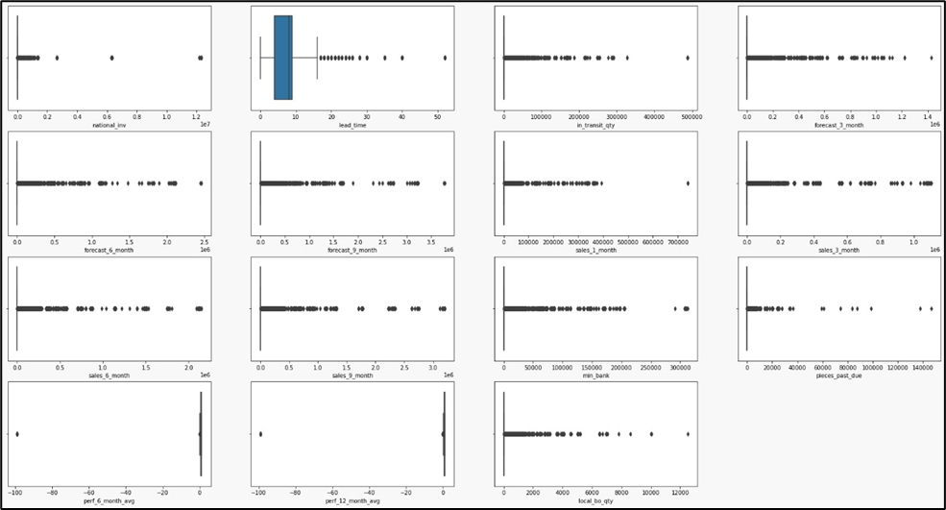
Outliers in Original Data
Skewness:

Slide 7
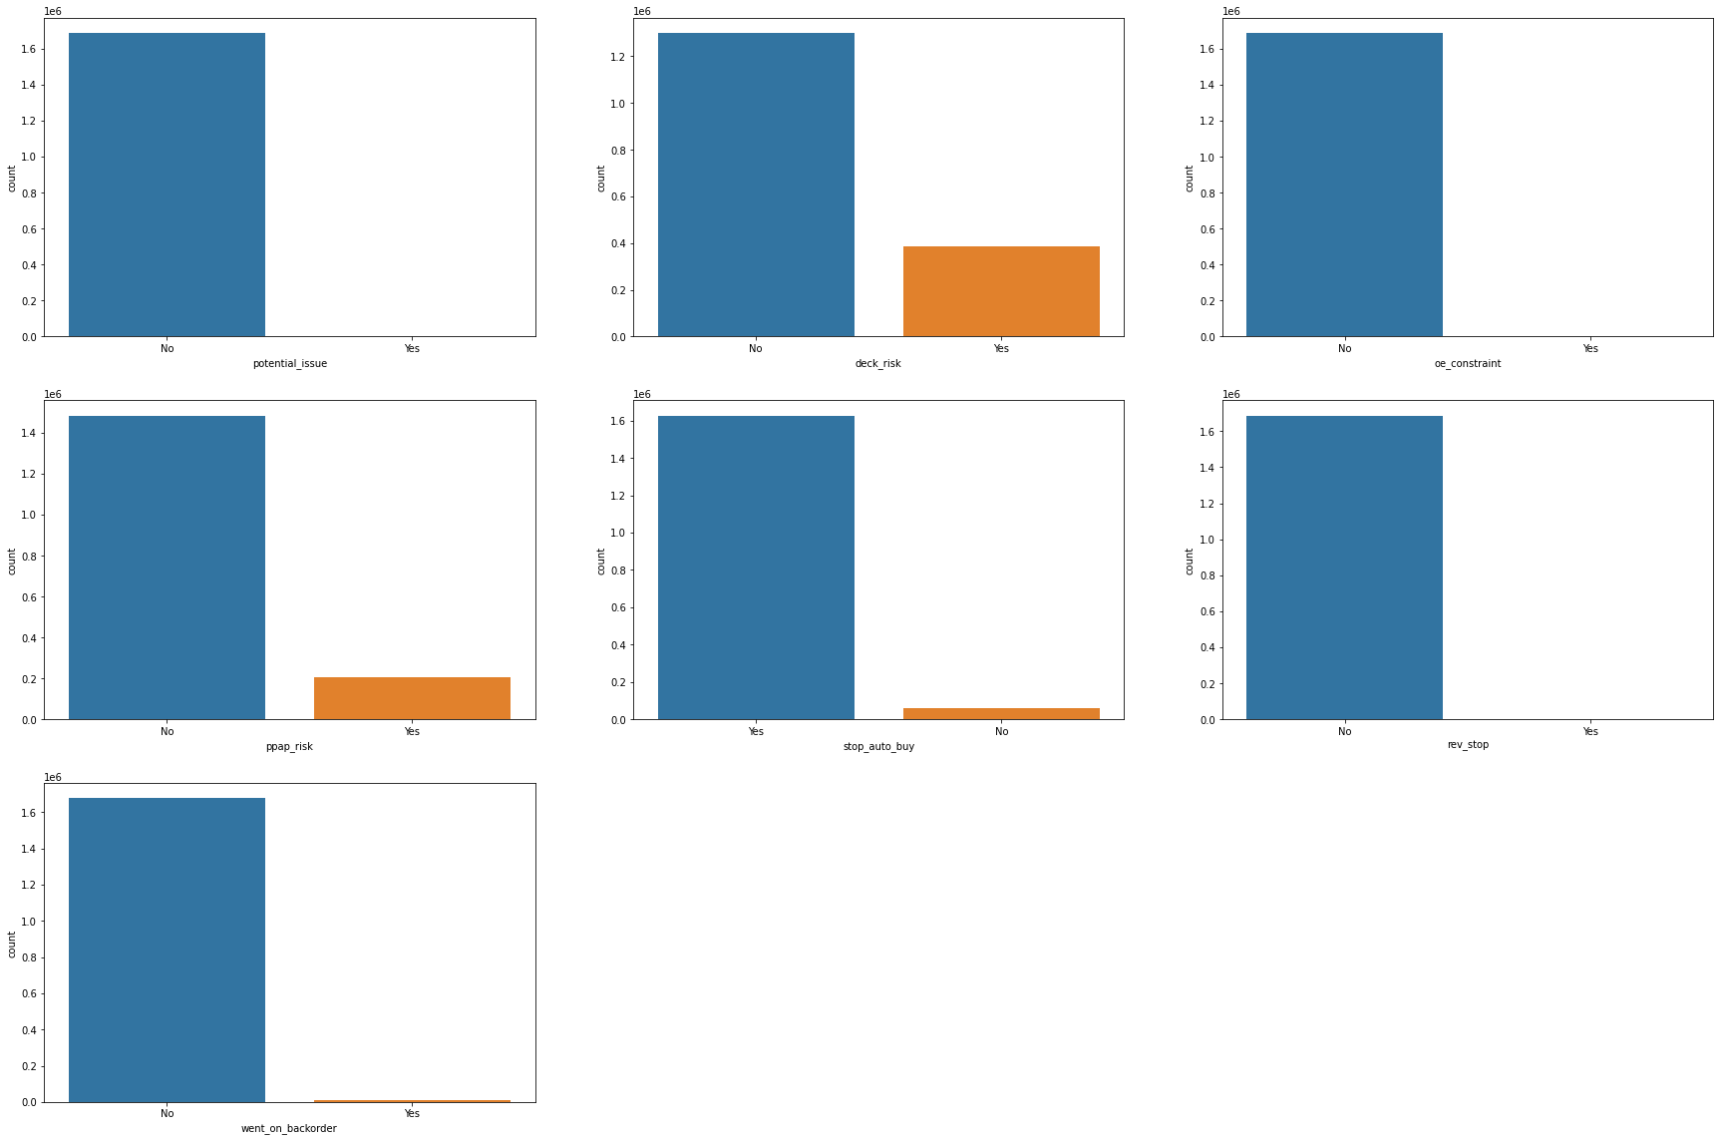
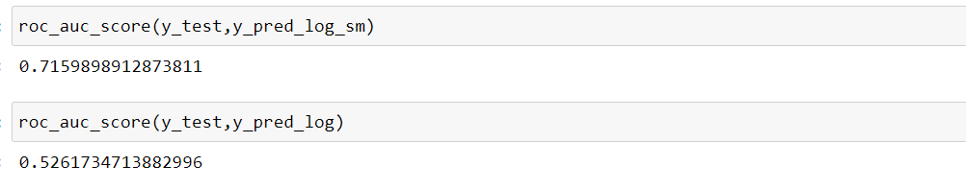



Visualization - Categorical Variables
Subplot (count plot) is drawn for all Category variables (except sku column).
All category variables are having ‘Yes’ and ‘No’ type of classification.
From subplot we can infer that deck_risk (2), ppap_risk(4) and stop_auto_buy(5) are showing considerate amount of distribution for minority class.
To be noted that, in feature stop_auto_buy , majority class is ‘Yes’.

Slide 8
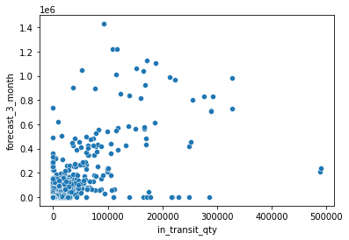
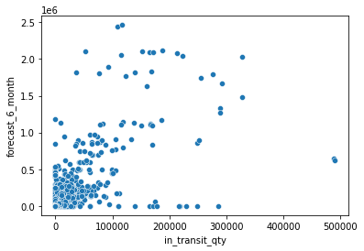
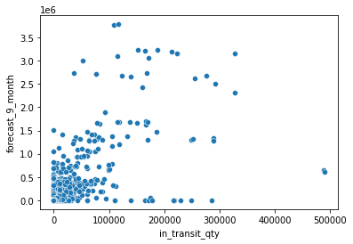
In-transit Vs Forecast sales
Above scatterplots shows relationship between intransit_quantity and forecast sales for 3,6,9 months respectively.
Based on heatmap, forecast_6_month shown correlation on higher side with in_transit_qty.
During model-building, we may drop 2 out of 3 columns, as they would be redundant feature affecting model prediction.

Slide 9
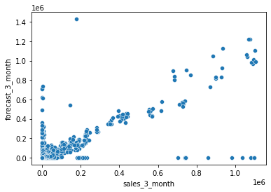
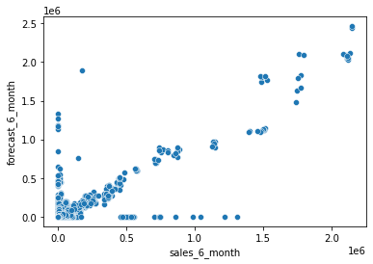
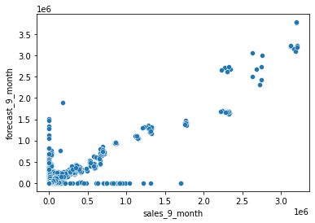
Sales Vs Forecast
Above scatterplots are plotted against Sales an Forecast of corresponding months (3,6,9).
Forecasted sale of quantity based on previous sales is predicted correctly based on the plot, as they follow positive (linear relationship).

Slide 10
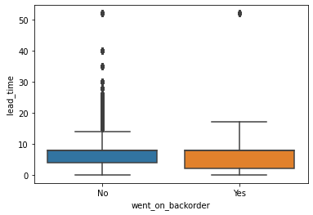
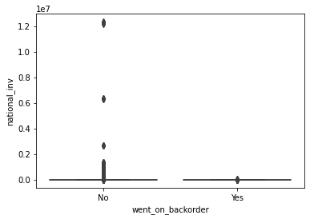
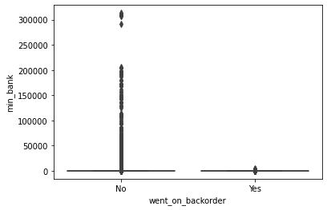
Lead Time, National_Inv, Min_bank Vs Target
Lead_Time
National_Inv
Min_bank
It can be inferred that median and Q3 quartile are same and data is extremely skewed.
Q1 and Q3 are between 5 to 10 weeks for Yes and No.
It can be inferred that national_inv (Q3 – 8qty) and Min_bank (3 qty) for is extremely skewed for No.

Slide 11
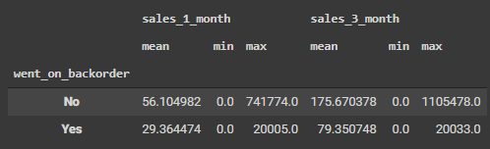
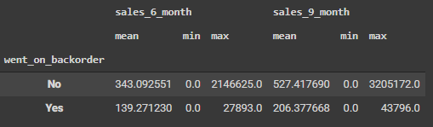
Sales vs Target variable
In Sales of last 1 and 3 months, it can be
inferred that whenever max-order quantity is
around 20,000 orders, product has gotten into Backorder.
Based on sale data of previous 6 & 9 months, we can observe that when max order qty is around 28,000 and 44,000, product went into Backorder.

Slide 12
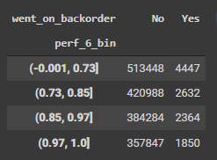
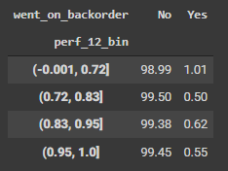
Source Performances Vs Backorder
Source performance are mentioned in percentages, so we have binned them into 4 bins
with respect to target variable.
We can infer that, when supplier performance is high (above 95%) product does not go
into backorder in 6 months.
For 12 months performance average, we cannot find a pattern (non-linear).

Slide 13
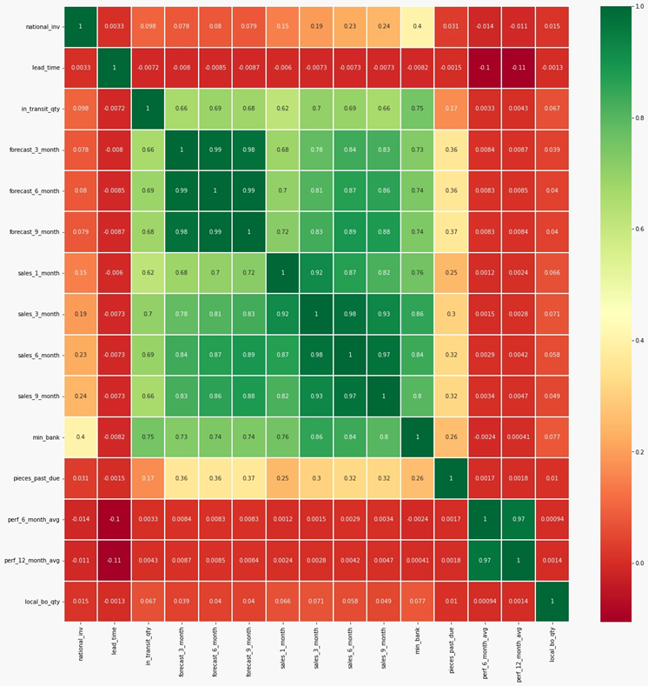
Multi-Variate Analysis - 1

Slide 14
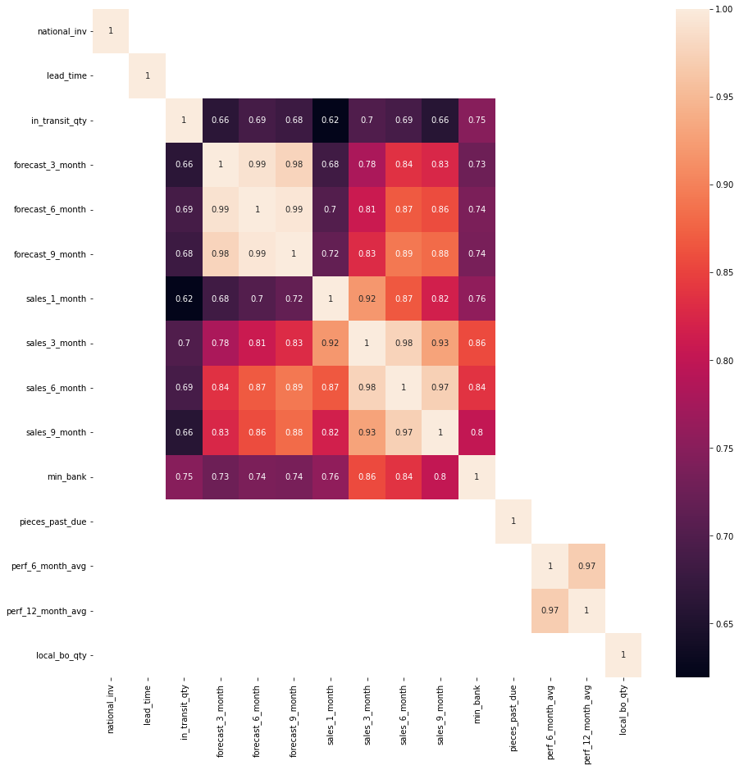
Multi-Variate Analysis - 2
We have filtered out factors which have high
correlation between features of 0.5.
Features : Forecast 3,6,9 and sales 1,3,6,9 months
In_transit_quantity are features having correlation of 0.5.

Slide 15
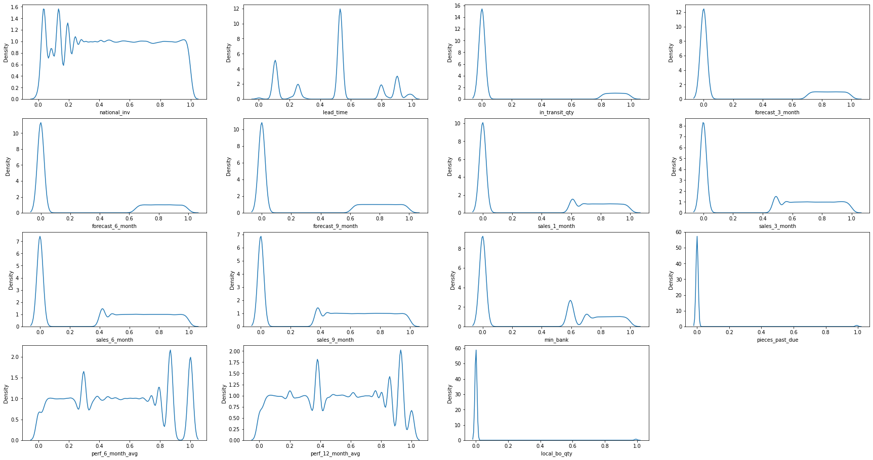
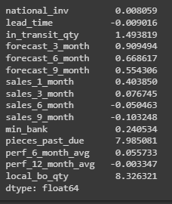
Distribution of Features After Scaling & Transformation
Train Test Split has been
Applied with 70 : 30 and
standardization and
transformation have been done
Skewness:

Slide 16
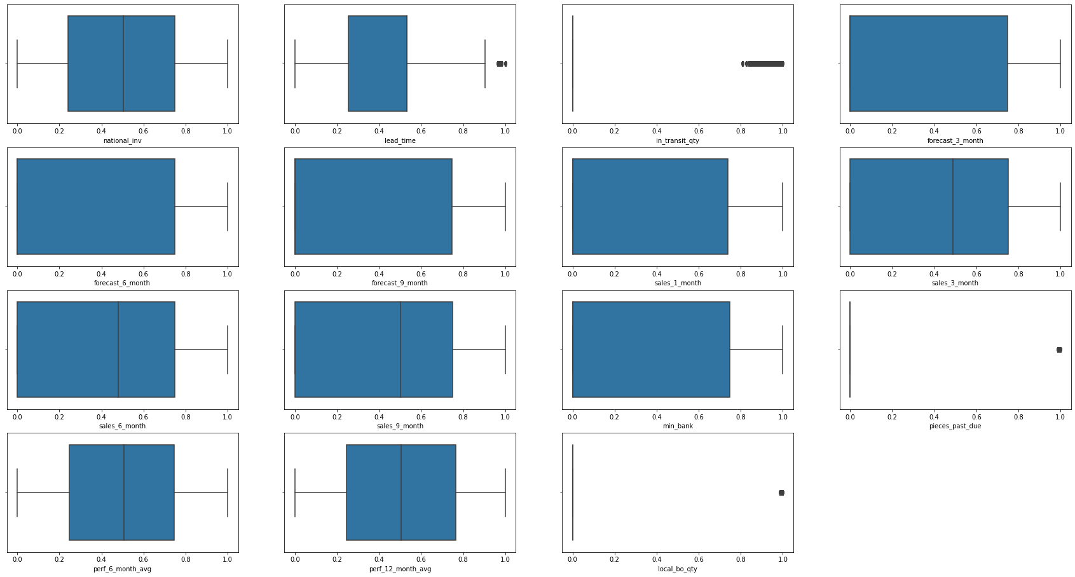
Distribution of Features After Scaling & Transformation

Slide 17
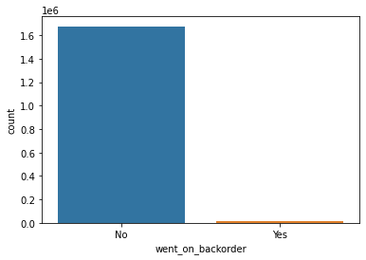
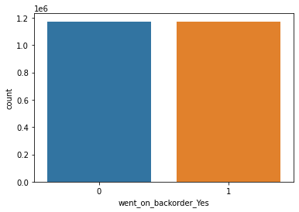
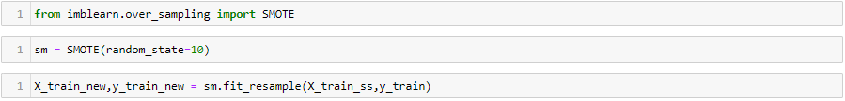
Handling Class Imbalance
Before SMOTE
After SMOTE
Due to the class imbalance , we may get a biased and overfitted model which is highly biased towards a majority class. So we are creating synthetic data using SMOTE for building the model.

Slide 18
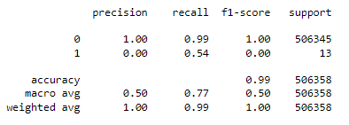
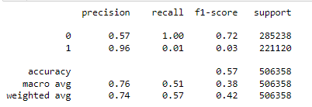


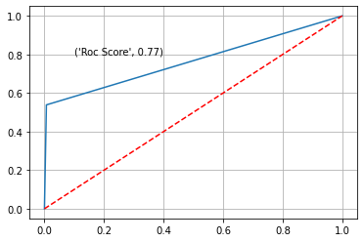
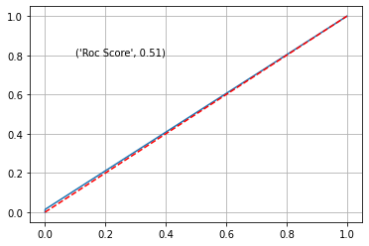
Model Building - Base
Logistic Regression – Base Model
We have used stats.models library for building Logistic Regression Model.
Out Target variable is “went_on_back” feature.
Before SMOTE
After SMOTE

Slide 19
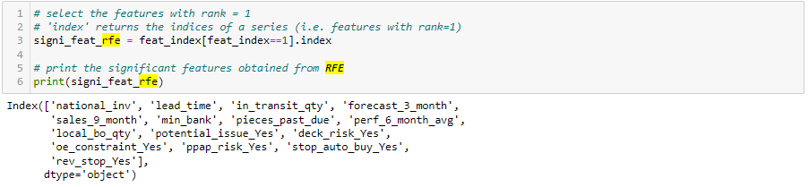
Feature Selection
We have used Recursive Feature Elimination (RFE), for selecting our features that give us the best model.
Based on the above features, we have started to build our base model using Logistic Regression

Slide 20
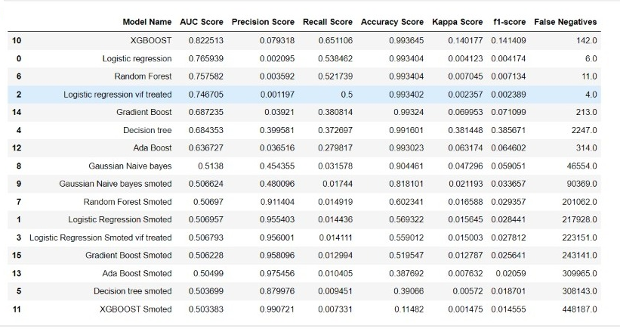
Model Score Card
Best Model
Base Model

Slide 21
Business Interpretation
We can able to predict the materials, so that company will be able to maintain sufficient stock to prevent the material going into backorder.
The prediction is done on quarterly basis, so that company can able to place purchase order for next quarter considering the lead time.
Therefore, Backorder prediction helps in reduces the waiting time when the order goes into out of stock due to unforeseen circumstances

Slide 22
Challenges & Scope
Challenges
Due to large volume of raw data and SMOTE, we had higher computation time which led to us
trying out limited number of models.
Limitation
Data is available for a certain period of time of the company, we are not aware whether holidays, season sales, natural calamities are also captured.
There can be a slight variation in prediction if unforeseen circumstances like COVID is to appear.
Scope
Handling Class Imbalance with Under Sampling Technique
Thresholding Adjustment

Slide 23
Thank You

